Slide 1
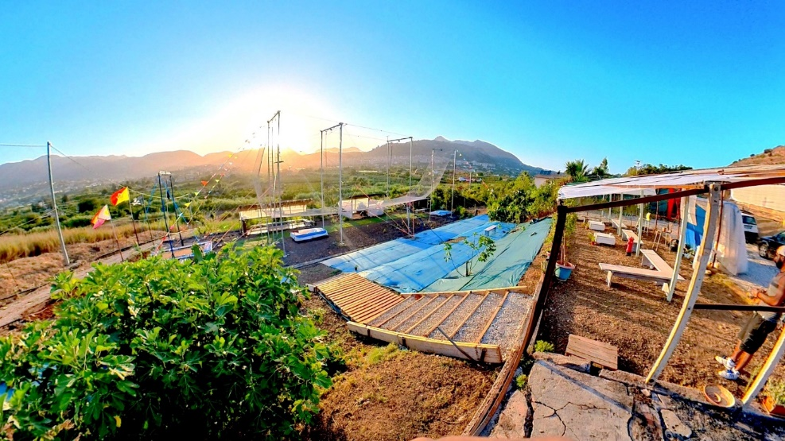
Where?
and When?
DAL 25 al 28 aprile
Palermo, Spazio Euphoria
Via emilia 4, 90144 palermo
Foto delle sala di spazio euphoria
Misilmeri, ALL VOLANTE
Contrada scaniglia, 90036 Misilmeri PA
INFO DI BASE:
2 location (1 indoor and 1 outdoor) con posizione e indirizzi
+ 9 teacher
+ 30 workshop
3 different levels (open, beg/int, int/adv)

Slide 2
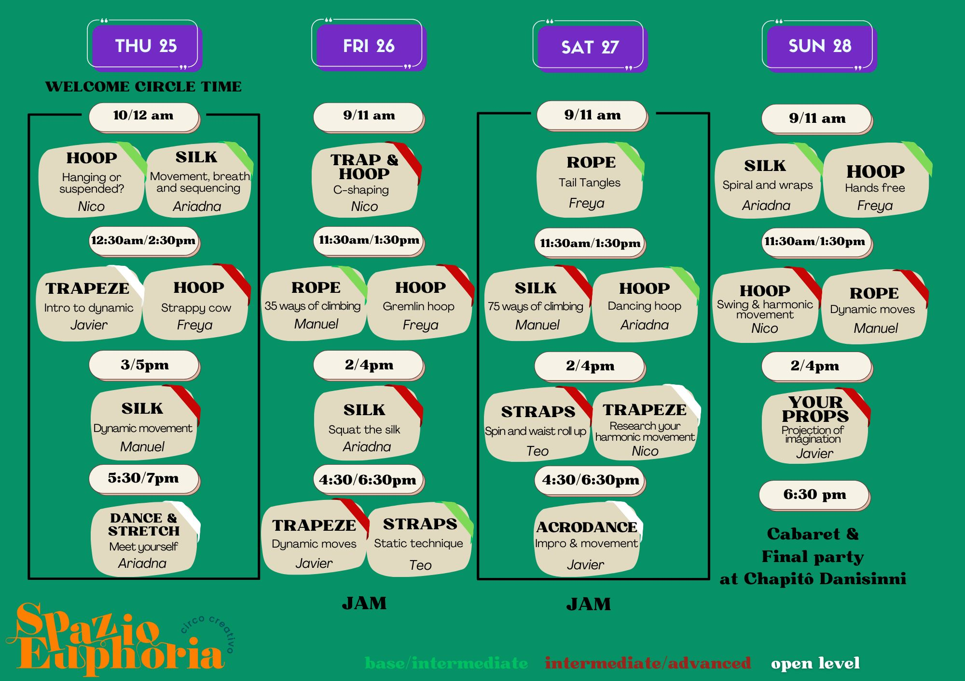
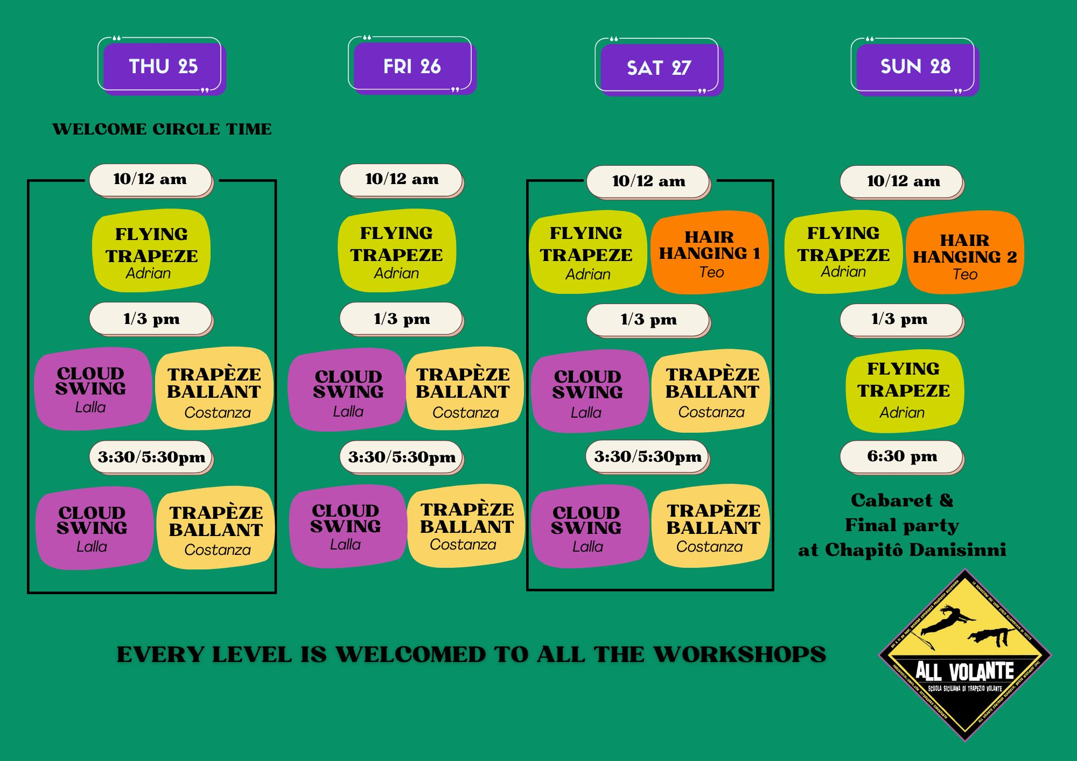
Schedule and packages
1. Where do I select my workshop?
Directly in the REGISTRATION FORM before Payment section
EARLY BIRD (until 29° february)
WORKSHOP PACK OFFER:
10 ws 900€ 700€
7 ws 700€ 550 €
5 ws 520€ 400 €
3 ws 330€ 250 €
COUPON AVAILABLE
EXTRAVAGANZA -10%, ATELIER 12 -10%
SPAZIO EUPHORIA -15%, ALL VOLANTE -15%
To get your coupon, ask to your school and insert the CODE into the registration form before payment
Se graficamente il palinsesto non ci sta mettere linktree e pace

Slide 3
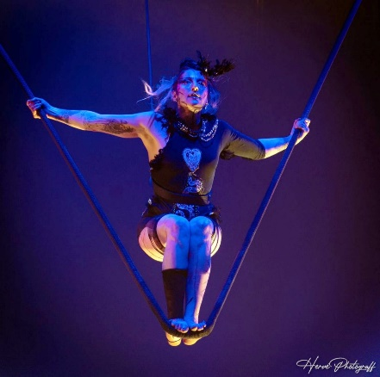
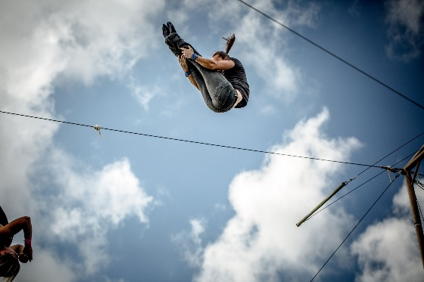
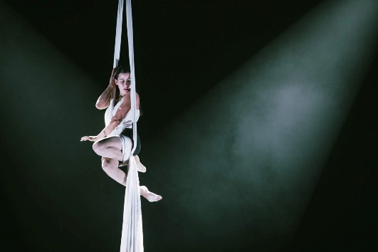
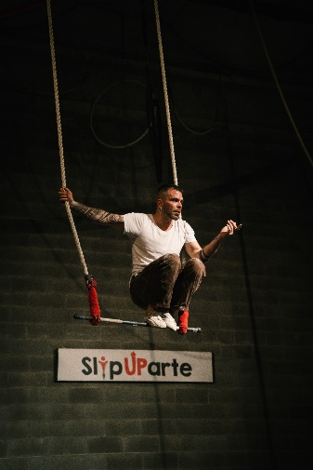
Teachers
Se riuscissimo a fare una pagina unica con palinsesto e insegnanti secondo me top
O collage foto insegnanti con noi e basta, oppure piccola foto e box informativo dei ws che faranno come es per javier
Acrodance
Dynamic Trapeze intro
Exploration on props

Slide 4
Shuttle service
Accomodation Service
3 bus shuttle from Spazio Euphoria to ALL Volante
3 bus shuttle from ALL Volante to Spazio Euphoria
Each race costs 15 euros and it includes round trip (departure/arrival from Spazio Euphoria or ALL VOLANTE)
TORREATA HOTEL, via dei bersaglieri, 90144, palermo
10 minutes on foot closeby Spazio Euphoria
5 minutes on foot closeby bus stop to center and train station
20 minutes by bus closeby the sea and Mondello’s beach or 40 minutes on foot
PRICES INCLUDES BREAKFAST!
BUS SHUTTLE TIMETABLE
25th, 26th and 27° april
BUS SHUTTLE TIMETABLE
28 th april
From S. Euphoria 8,30
From S. Euphoria 11,30
From S. Euphoria 14,00
From A. Volante 12,30
From A. Volante 15,30
From A. Volante 18,00
From S. Euphoria 8,30
From S. Euphoria 11.30
From A. Volante 12,30
From A. Volante 15,30
Private single room 65€
Double shared room 40€
Double private room 45€
Mix Dorm room (max 3 people) 35€
Mix Dorm room (max 4 people) 30€
Where do I select my race?
Directly in the REGISTRATION FORM before Payment section. During the form, the number of bus shuttle you need to book is automatically calculated based on workshop you selected
Where do I select my room?
After the REGISTRATION FORM you will be redirected to the accomodation form. Choose the room you prefer, your roommate if you have (otherwise the combination will be random) and the number of night.
WATCH OUT
Bus shuttle get the destination in 40 minutes but you need to consider 2 houres of delay between classes at spazio euphoria and all volante or viceversa

Slide 5
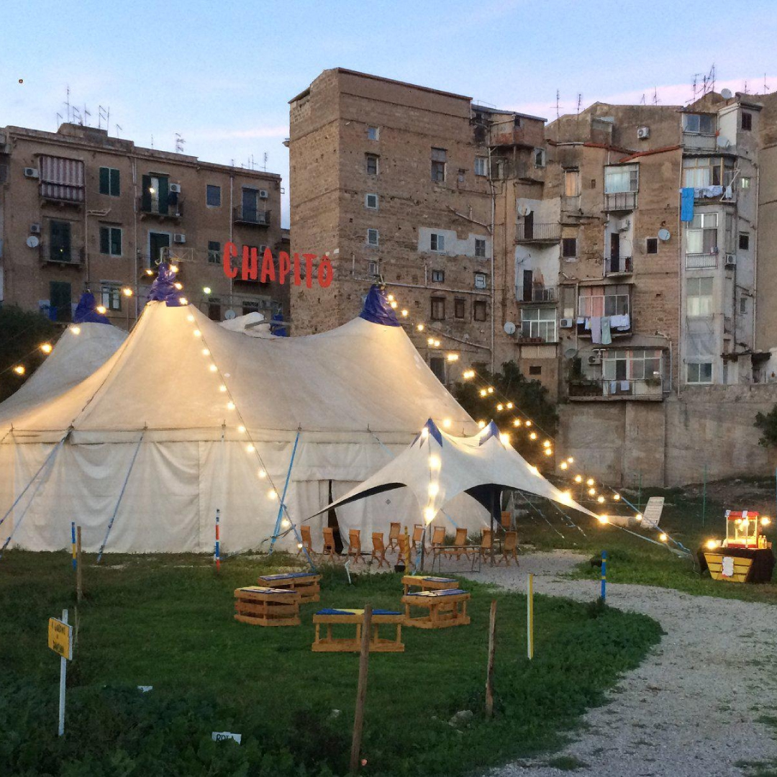
Final Cabaret and Final Party
At the end of the convention, during the 27° evening from 6.30 pm, Chapito Danisinni will host the final cabert done by teachers and partecipant of the convention inside the chapito and the farm in Danissinni square
Farsi mandare foto in alta risoluzione da chapito o prendere quelle da internet
Do you want to perform?
You can send an email to aerialconventionexperience@gmail.com or write a whatsapp to Valeria +39 3282551159 with the following info:
Act name,
Duration and music
Props and technical issues required
After the cabaret a great party will happen at Chapito Danisinni in order to close the convention dancing, singing, eating and drinking all together.

Slide 6
ASK for ASC?
1. Where do I select my workshop? and where can i find out the description?
You can check the pdf file called «Workshop description» on ASC page and then select the workshop you prefer within the REGISTRATION FORM before Payment section
2. Where do I select my race?
Directly in the REGISTRATION FORM before Payment section. During the form, the number of bus shuttle you need to book is automatically calculated based on workshop you selected
3. Where do I select my room?
After the REGISTRATION FORM you will be redirected to the accomodation form. Choose the room you prefer, your roommate if you have (otherwise the combination will be random) and the number of night.
4. Lunch service is provided?
Lunch service is not included in the options, but there are a lots of supermarkets, restaurants and cafè near the locations (both Spazio euphoria and torreata hotel).
In case you book ALL VOLANTE classes all day long then you can get more info about the special lunch service.
5. How can I join?
Places are limited and to book your place click the sign up button on the website!
6. How can I choose the workshop I prefer?
You can follow your favorite teacher, you can also selected workshop per props, you could only decide to attend class 1 day or only 2 out 4 days. Definitely you can choose as you wish!
7. Do you want to perform?
You can send an email to aerialconventionexperience@gmail.com or write a whatsapp to Valeria +39 3282551159 with the following info:
Act name,
Duration and music
Props and technical issues required

Slide 7
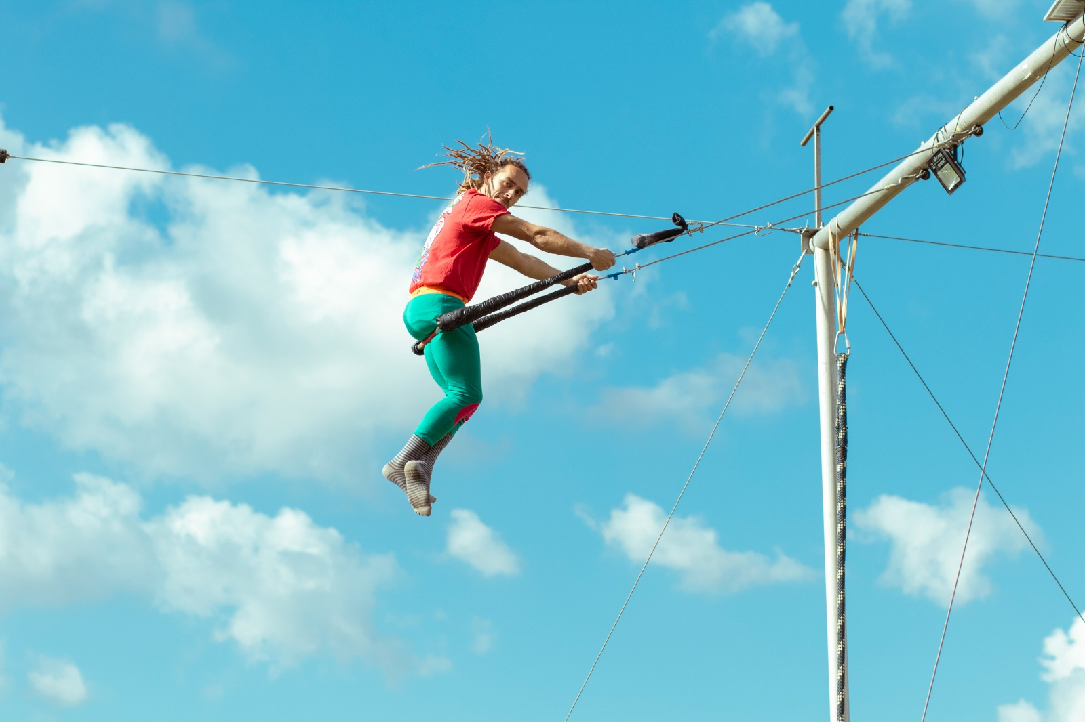
ASC ORGANIZATION & CONTACT
Ig e fb di spazio euphoria e all volante
Scheduling manager: Valeria Cultrera +393282551159
Bus shuttle and accomodation services: Antonella Di Fiore +39 3274232730
Final party and Cabaret manager: Federica Pantaleo +39 3331459136
Registration and accountability manager: Angela Ciulla +39 3282942145
Communications manager: Chiara maniscalco+39 3288349528

